Slide 1
Image Steganography For Cyber Security Using C# & .NET Framework
By
Debasis Kar (10908166)
Roopali Sahoo (10901410)
Abhishek Kapoor (10900073)
Project Group Number: KG005
Under The Guidance Of
Er. Sawal Tandon
Assistant Professor, CSE
CAPSTONE PROJECT-I (Aug-Dec, 2012)
Lovely Professional University, Punjab, India

Slide 2
Project Overview
Steganography with Image is a desktop application.
The purpose of this application is to provide the security for the confidential information. This application does not allow the hackers to view the data, can view only image file when it is being passed over the internet.
At the recipient side the original information i.e., plain text will be extracted from the image by performing decryption operations.
This application uses C#.NET to develop GUI and perform encryption and decryption operations.
One can make it pure steganography application including features such as for cyber security:
E-Mail Application
E-Mail Client Service
Chat Applications
Banking Applications For Safer Data Traffic
Group Messaging Simulation

Slide 3
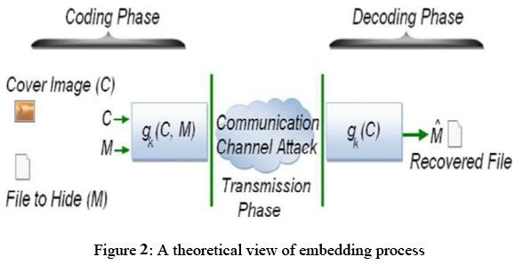
Steganography
Steganography comes from the Greek “Steganos”, which mean “Covered” and “Graphy” mean “Writing or Drawing”. Therefore, steganography mean, literally, “Covered Writing”.
It is the art and science of hiding information such its presence cannot be detected and a communication is happening. The main goal of this projects it to communicate securely in a completely undetectable manner and to avoid drawing suspicion to the transmission of a secret data.
The basic model of steganography consists of Carrier and Message. Carrier is also known as cover-object, which the message is embedded and serves to hide the presence of the message.

Slide 4
Steganography vs Cryptography
Cryptography hides the contents of a secrete message from a malicious people, whereas steganography even conceal the existence of the message.
In cryptography, the system is broken when the attacker can read the secret message. Breaking a steganography system need the attacker to detect that steganography has been used.
It is possible to combine the techniques by encrypting message using cryptography and then hiding the encrypted message using steganography. The resulting stego-image can be transmitted without revealing that secret information is being exchanged.

Slide 5
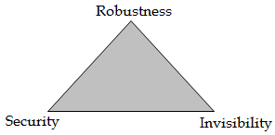
Steganography vs Water Marking
Steganography pay attention to the degree of Invisibility while watermarking pay most of its attribute to the robustness of the message and its ability to withstand attacks of removal, such as image operations (rotation, cropping, filtering), audio operations(rerecording, filtering).
Robustness refers to the “Endurance Capability” of the message to survive distortion or removal attacks intact. It is often used in the watermarking field since watermarking seeks the persistence of the watermark over attacks, steganography messages on the other hand tend to be of highly sensitive to such attacks.

Slide 6
Steganography
There are several suitable carriers below to be the cover-object:
Network protocols such as TCP, IP and UDP
Digital audio formats such as wav, midi, mp3.
Digital video formats such as avi, mpeg and mkv
Text such as null characters, just alike Morse code including html and java
Images file such as BMP, GIF and JPEG, where they can be both color and gray-scale.

Slide 7
Image Steganography
Image steganography techniques can be divided into two groups:
Image Domain techniques encompass bit-wise methods that apply bit insertion and noise manipulation. The image formats that are most suitable for image domain steganography are lossless and the techniques are typically dependent on the image format.
Transform Domain involves the manipulation of algorithms and image transforms. These methods are independent of the image format and the embedded message may survive conversion between lossy and lossless compression

Slide 8
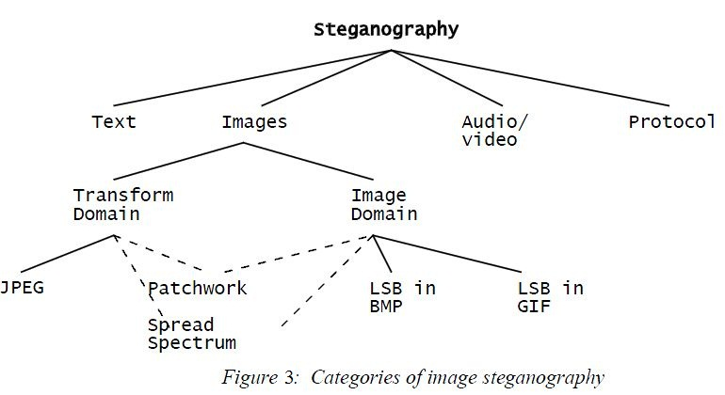
Image Steganography

Slide 9
Least Substitution Method
Least significant bit (LSB) insertion is a common, simple approach to embedding information in a cover image. The least significant bit (in other words, the 8TH bit) of some or all of the bytes inside an image is changed to a bit of the secret message.
When using a 24-bit image, a bit of each of the R, G and B color components can be used, since they are each represented by a byte.
For Example,
A grid for 3 pixels of a 24-bit image can be as follows:
(00101101 00011100 11011100)
(10100110 11000100 00001100)
(11010010 10101101 01100011)
When the number 200, which binary representation is 11001000, is embedded into the LSB of this part of the image, the resulting grid is as follows:
(00101101 00011101 11011100)
(10100110 11000101 00001100)
(11010010 10101100 01100011)
Since there are 256 possible intensities of each primary color, changing the LSB of a pixel results in small changes in the intensity of the colors. These changes cannot be perceived by the human eye - thus the message is successfully hidden.

Slide 10
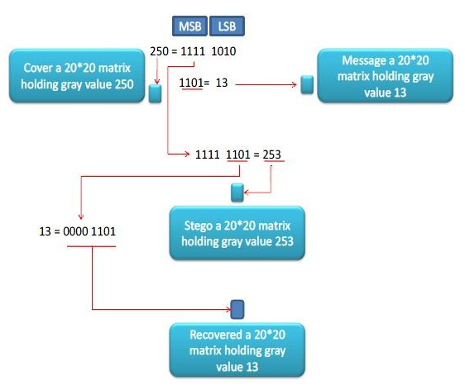
Least Substitution Method

Slide 11
JPEG Steganography
JPEG file can be encoded JFIF encoding that consists of several steps:
The representation of the colors in the image is converted from RGB to Y′C_{B}C_{R}.
The resolution of the Chroma data is reduced, usually by a factor of 2.
The image is split into blocks of 8×8 pixels, and for each block, each of the Y, C_{B}, and C_{R} data undergoes the Discrete Cosine Transform (DCT).
The amplitudes of the frequency components are quantized.
The resulting data for all 8×8 blocks is further compressed with a lossless algorithm, a variant of Huffman encoding.
During the DCT transformation phase of the compression algorithm, rounding errors occur in the coefficient data that are not noticeable. Although this algorithm is lossy, this property can be used to hide messages.
Using the same principles of LSB insertion the message can be embedded into the least significant bits of the coefficients before applying the Huffman encoding. By embedding the information at this stage, in the transform domain, it is extremely difficult to detect, since it is not in the visual domain.

Slide 12
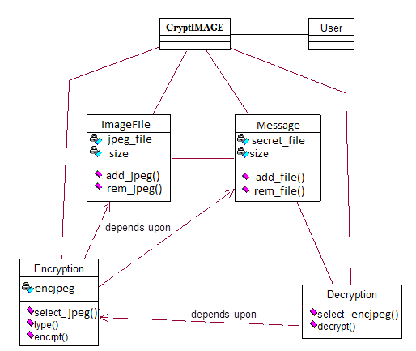
UML Diagrams : CLASS Diagrams

Slide 13
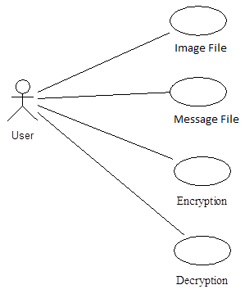
UML Diagrams : Use Case Diagrams

Slide 14
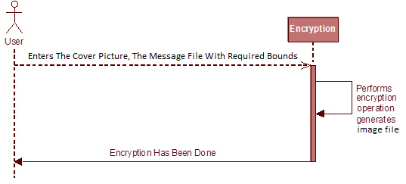
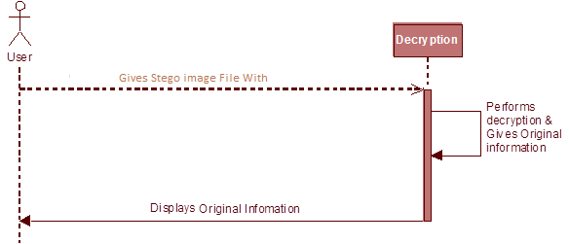
UML Diagrams : Sequence Diagrams

Slide 15
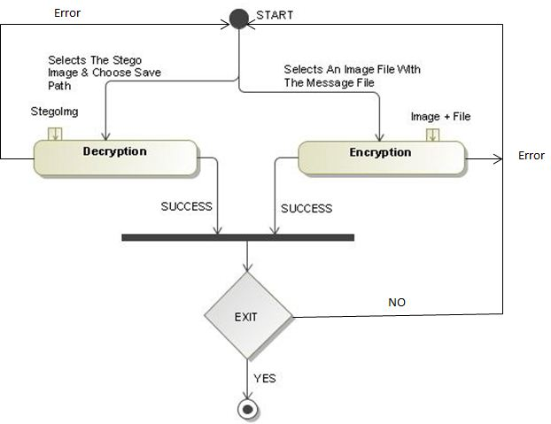
UML Diagrams : Activity Diagrams

Slide 16
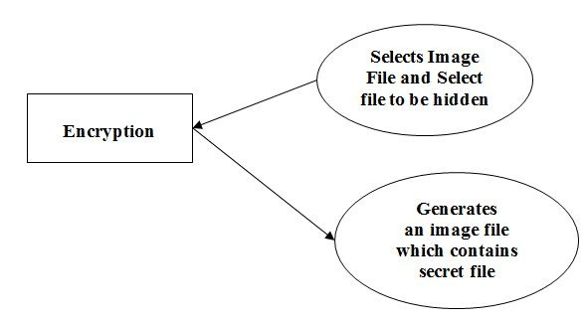
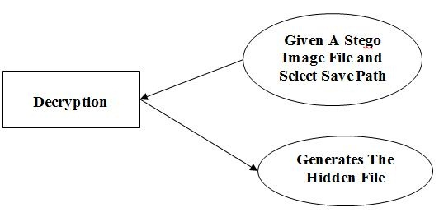
UML Diagrams : DFDs (Level-II)

Slide 17
Technical Details-I
Used Namespaces:
System.IO
System.Text
System.Drawing
System.Drawing.Imaging
System.Security.Cryptography
Used Classes:
Image
Bitmap
Rectangle
FileInfo

Slide 18
Technical Details-II
Hardware Requirements
⊕ Processor: Pentium-III (or) Higher
⊕ Ram: 64MB (or) Higher
⊕ Cache: 512MB
⊕ Hard disk: 10GB
Software Requirements
⊕ Operating System: Windows NT/2000/XP/Vista/7/8
⊕ Languages: Visual C#
⊕ Framework: Microsoft .NET 3.0 (minimum)
Modules:
Graphical User Interface
Encryption With Image File
Decryption With Image File
Application Module

Slide 19
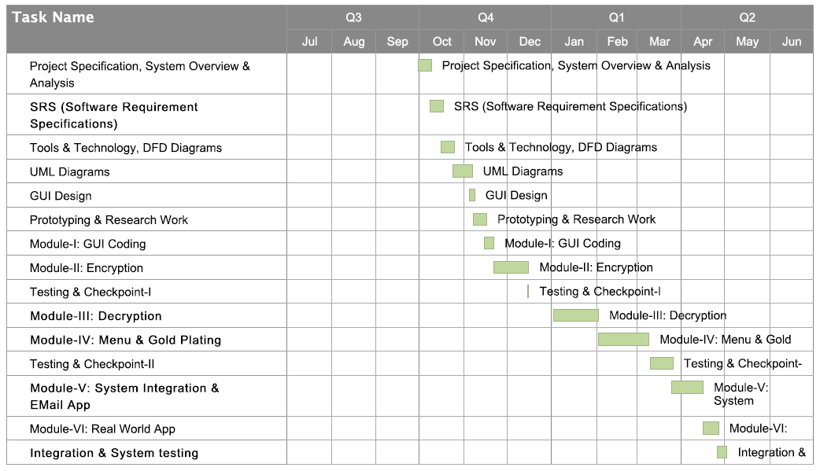
Project Planning

Slide 20
Roles In Project
Designing
Coding
Testing
Database

Slide 21
Future Scope
To make it pure steganography application including features such as:
E-Mail Application
E-Mail Client Service
Chat Applications
Banking Applications For Safer Data Traffic
Group Messaging Simulation

Slide 22
References
Journals:
Steganography Algorithm To Hide Secret Message Inside An Image, Rosziati Ibrahim And Teoh Suk Kuan , Faculty Of Computer Science And Information Technology, University Tun Hussein Onn Malaysia (UTHM), Malaysia.
Current Steganography Approaches: A Survey Sara Natanj, Taghizadeh, Department Of Industrial Engineering, Kahje-Nassir University Of Technology, Tehran, Iran.
An Overview Of Image Steganography, T. Morkel, J.H.P. Eloff, M.S. Olivier, Information And Computer Security Architecture (ICSA) Research Group, Department Of Computer Science, University Of Pretoria, Pretoria, South Africa.
Books:
CLR via C# by Jeffrey Richter, Tata McGraw Hill Publications.
Professional .NET 4.0 Framework by Joe Duffy, PHI.
C# in Depth by Jon Skeet, 4th Edition, PHI.
Wrox Press Beginning C# 3.0-An Introduction To Object Oriented Programming.

Slide 23
THANK YOU

